Slide 1
UCR 2016-2017 MEI Class: Cultivating a Community of Respect Hiring Manager’s Guidelines on Recruiting
Tanya Adams, Loren Bacallo, Anna Finn, Carie Wilkens-Smith

Slide 2
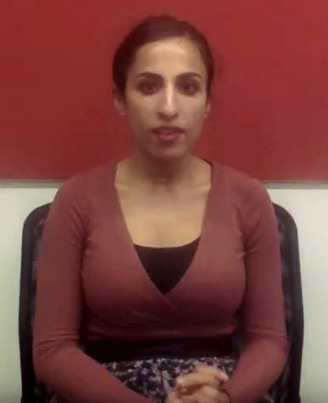
Student Testimonial
“Initially I’d been drawn to UCR as a school because of their claim to diversity and how great that felt, feeling like the campus that I was attending…really valued making me as an individual feel like I belonged and I wasn’t somebody who stood out and had no one to relate to.”
Deema Akari
M.D. Candidate, Class of 2019
UCR School of Medicine
UCR Graduate, BCOE, Bioengineering

Slide 3
Problem Definition
Many issues within our search process are preventing us from hiring the most diverse and qualified candidates.
Our students rely on our staff and faculty for their academic and personal development, however, if we do not have a staff that is diverse our students suffer.
Hiring managers make decisions at several points in the process which limit or discount the input of the entire search committee.
Factors other than skills and qualifications may be driving how search committees determine “qualified” candidates.
The AACL has not been provided with sufficient training to properly address problems and concerns.
Search committee members do not feel empowered to voice important questions or concerns during the search process.

Slide 4
Suggested Policy Changes
Hiring managers must not conduct initial screenings of applicants.
All search committee members should meet with hiring managers at the beginning and end of the search.
AACLs will not report to the hiring manager but will be drawn from a trained pool of volunteers.

Slide 5
Suggested Policy Changes:
Affirmative Action Compliance Liaison Training Program
Take Implicit Bias training online before the session. Bring results to discuss.
Advertising and building a diverse candidate pool
The Role of the AACL including techniques for addressing bias and methods of escalation
Discussion of three case studies that address common search committee issues

Slide 6
AACL Resources
Search committee members have several options when it comes to bringing up concerns or grievances.
HR
Speak directly to the Chair or hiring manager. (This may be the same individual in some searches.)
The Ombuds is a confidential, impartial, informal and independent resource that assists the UCR community members in addressing or resolving a conflict or dispute.
Central Human Resources Talent Acquisition Department or your team Human Resources Business Partner, they will be able to provide guidance on compliance with local and UC policies as it pertains to recruitment.
Contacting the OFCCP for an independent review of the recruitment for compliance. This action would require intervention at the federal level.

Slide 7
Potential Risks
Objection to policy changes and hiring manager’s resistance to policy changes.
Soliciting volunteers to build a network of AACL’s.
AACL not feeling empowered to act in the best interest of the program objectives.

Slide 8
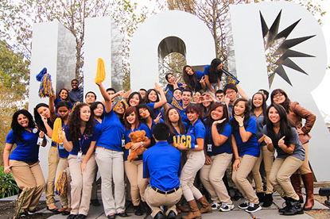
Benefits
Recruiting a diverse staff is key to supporting our diverse student body. These policy changes will have long-term effects on the composition of the UCR staff and the success of the students we serve.

